Slide 1
Random Forest

Slide 2
Outline
Introduction
Basic Terms
Algorithm
Pros and Cons
Applications

Slide 3
Introduction
Random forests is an ensemble learning method for classification, regression , that operate by constructing a multitude of decision trees at training time and outputting the class that is the mode of the classes (classification) or mean prediction (regression) of the individual trees.

Slide 4
Basic Terms
Decision Tree
1.start with all variables in one group
2. find the variable that best splits the outcomes into two groups
3. divide data into two groups (leaves) based on the split performed (node)
4. within each split, find variables to split the groups again
5. continue this process until all groups are sufficiently small/homogeneous/“pure”

Slide 5
Example :
Action Movie ?
Yes
No
Actor=Salman Khan ?
Dislike
Yes
No
Like
Dislike

Slide 6



Measure of Impurity
Where, Is the probability of the objects in group m To take on the classification k
Nm is the size of the group
Gini Index
0 = perfect purity
0.5 = no purity

Slide 7
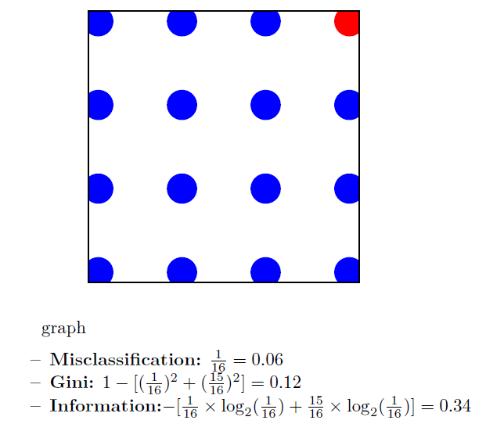

Slide 8
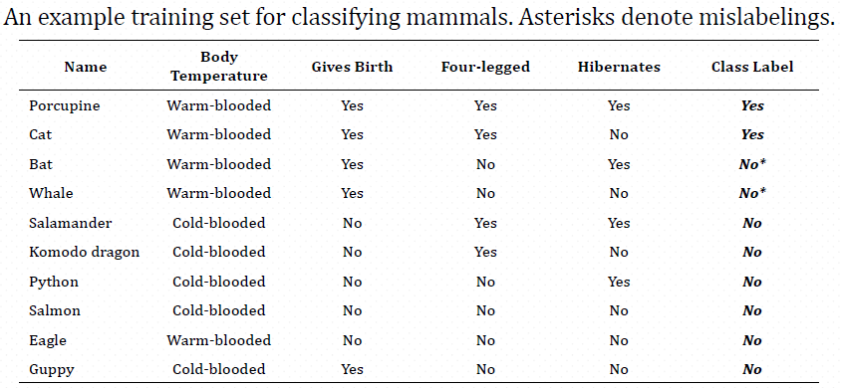
Overfitting of Decision Tree

Slide 9
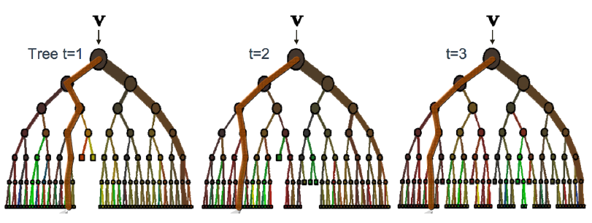
Ensemble Classifier

Slide 10
Bagging(Bootstrap Aggregating)
bootstrap samples from training data (with replacement)
OOB(Out Of Bag):
Data which do not present in the Bootstrap sample.

Slide 11
Random forest Algorithm
Select ntree, the number of trees to grow, and mtry, a number no larger than number of variables.
For i = 1 to ntree:
Draw a bootstrap sample from the data. Call those not in the bootstrap sample the "out-of-bag" data.
Grow a "random" tree, where at each node, the best split is chosen among mtry randomly selected variables. The tree is grown to maximum size and not pruned back.
Use the tree to predict out-of-bag data.
In the end, use the predictions on out-of-bag data to form majority votes.
Prediction of test data is done by majority votes from predictions from the ensemble of trees.

Slide 12
Example
Salary bands :
Band 1 : Below $40,000
Band 2: $40,000 – 150,000
Band 3: More than $150,000
Tree 1: Variable Age
 | Salary Band | 1 | 2 | 3
Age | Below 18 | 90% | 10% | 0%
 | 19-27 | 85% | 14% | 1%
 | 28-40 | 70% | 23% | 7%
 | 41-55 | 60% | 35% | 5%
 | >55 | 70% | 25% | 5%

Slide 13
Tree 2 : Variable Gender
Tree 3 : Variable Education
 | Salary Band | 1 | 2 | 3
Gender | Male | 70% | 27% | 3%
 | Female | 75% | 24% | 1%
 | Salary Band | 1 | 2 | 3
Education | High School | 85% | 10% | 5%
 | Diploma | 80% | 14% | 6%
 | Bachelors | 77% | 23% | 0%
 | Masters | 62% | 35% | 3%

Slide 14
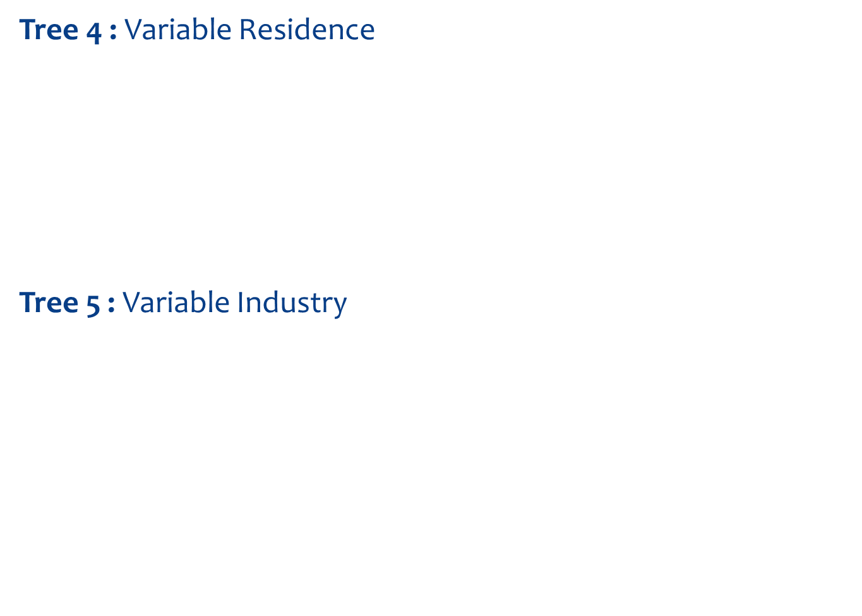
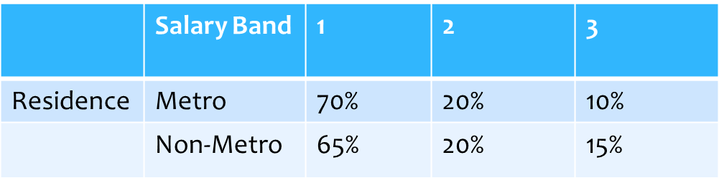
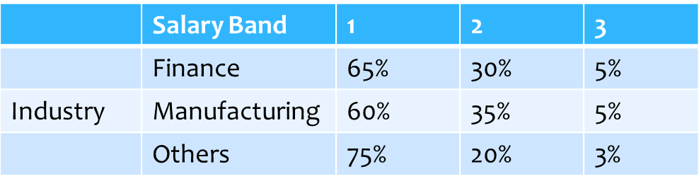

Slide 15
Age : 35 years ,Gender : Male ,Education : Diploma holder, Industry : Manufacturing, Residence : Metro
 | Band | 1 | 2 | 3
Age | 28-40 | 70% | 23% | 7%
Gender | Male | 70% | 27% | 3%
Education | Diploma | 80% | 14% | 6%
Industry | Manufacturing | 60% | 35% | 5%
Residence | Metro | 70% | 20% | 10%
 | Final Probability | 70% | 24% | 6%

Slide 16
Pros
This algorithm can solve both type of problems i.e. classification and regression and does a decent estimation at both fronts.
One of benefits of Random forest is the power of handle large data set with higher dimensionality.

Slide 17
cons
Random forests have been observed to overfit for some datasets with noisy classification/regression tasks.
For data including categorical variables with different number of levels, random forests are biased in favor of those attributes with more levels. Therefore, the variable importance scores from random forest are not reliable for this type of data.

Slide 18
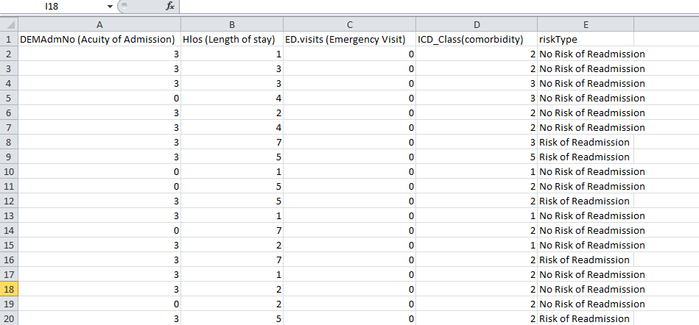
Medical Dataset:

Slide 19
R-Code ##DECISION TREE
# R code to import data
datasets <- read.csv("C:/Users/madhumitaj/Desktop/R/Seminar Random Forest/dataset.csv", header <- TRUE, sep <- ",")
library(caret)
inTrain <- createDataPartition(y=datasets$riskType, p=0.7, list=FALSE)
training <- datasets[inTrain,]
testing <- datasets[-inTrain,]
# fit classification tree as a model
modFit <- train(riskType ~ ., method="rpart", data=training)
# print the classification tree
print(modFit$finalModel)
rattle::fancyRpartPlot(modFit$finalModel)

Slide 20
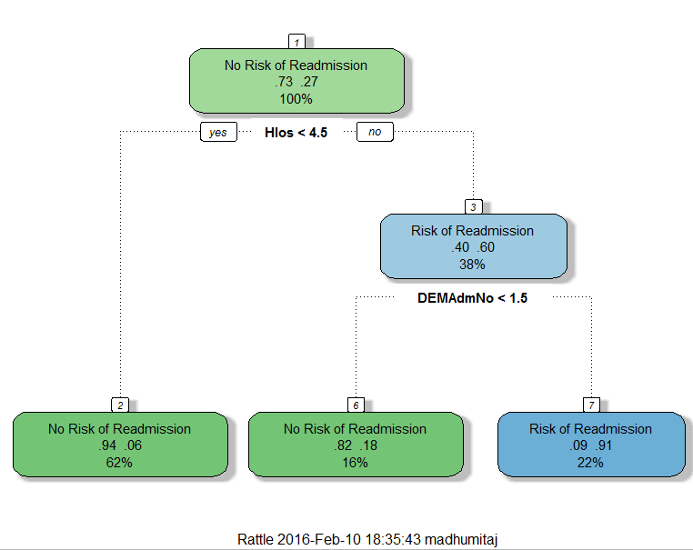
Output of Decision Tree :

Slide 21
RANDOM FOREST CLASSIFICATION PLOT
names(datasets)
library(randomForest)
datasets.rf <- randomForest::randomForest(datasets[,-5], datasets[,5], prox=TRUE)
datasets.rf
datasets.p <- randomForest::classCenter(datasets[,-5], datasets[,5], datasets.rf$prox)
datasets.p
plot(datasets[,2], datasets[,4], pch=21, xlab=names(datasets)[2], ylab=names(datasets)[4],
bg=c("green", "red")[as.numeric(factor(datasets$riskType))],
main="Medical Data with Prototypes")
legend("topright", pch = 1, col = c("green", "red"), legend = c("No Readmission", "Readmission"))
points(datasets.p[,2], datasets.p[,4], pch=21, cex=2, bg=c("green", "red"))
#Finding Accuracy
x<-datasets.rf$confusion
z<-x[,-3]
library(psych)
Accuracy<-tr(z)/nrow(datasets)
Accuracy
[1] 0.9666667

Slide 22
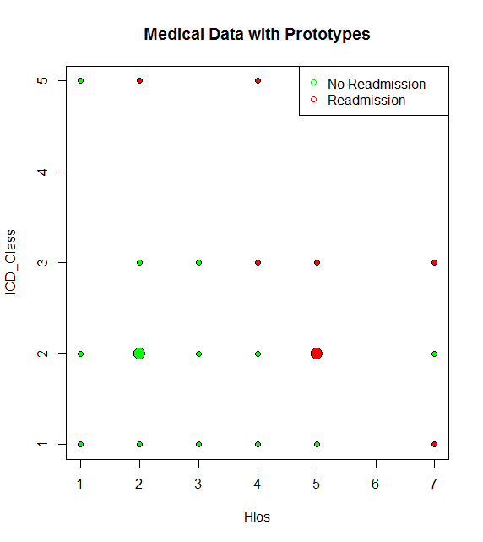
Output of Classification using RF :
Where,
ICD_Class : Comorbidities
Hlos : Length of Stay

